Slide 1
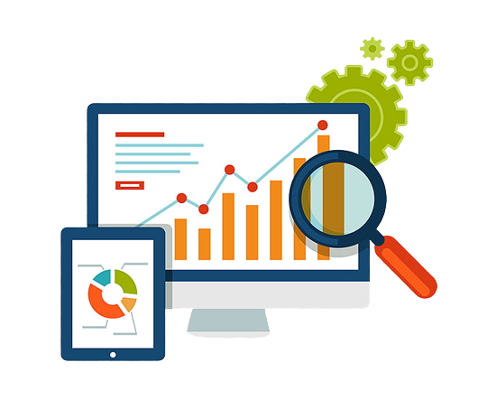
Data ecosystem, data lifecycle, and building your analytical skill set.
Continue
In this module, we will data ecosystem, data analysis life cycle and building your analytical skill set.

Slide 2
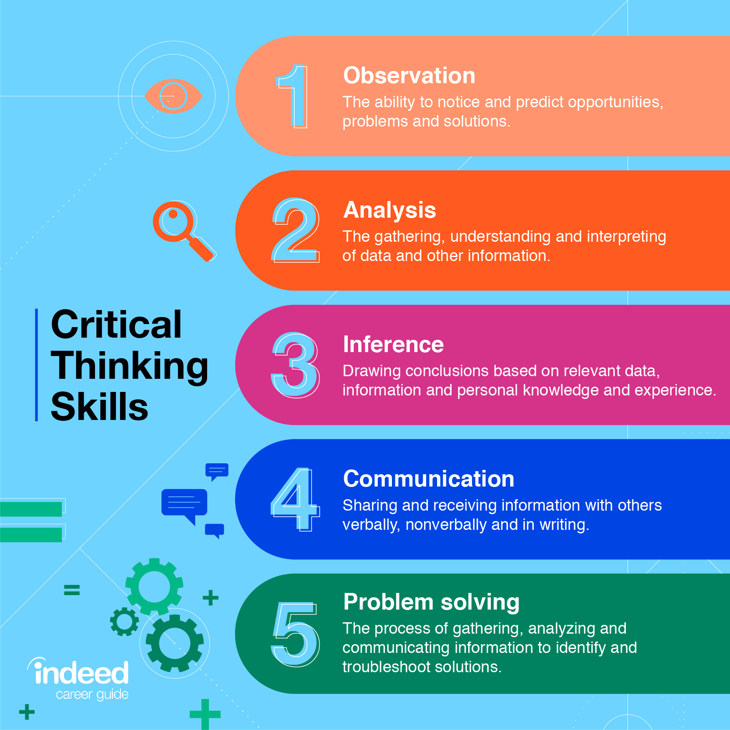
Critical thinking skills are a valuable asset for data analysts.
Properly analyzing information
Creative thinking.
Identify trends and patterns in data
Be an objective and rational thinker
Image source: https://peachyessay.com/blogs/critical-thinking/

Slide 3
Data analysis life cycle—the process of going from data to decision. Data goes through several phases as it gets created, consumed, tested, processed, and reused.
The data analysis process presented as part of the Google Data Analytics Certificate is one that will be valuable to you as you keep moving forward in your career. They include:
Ask: Business Challenge/Objective/Question
Prepare: Data generation, data collection, storage, and data management.
Process: Data cleaning/data integrity
Analyse: Data exploration, visualization, and analysis
Share: Communicating and interpreting results
Act: Putting your insights to work to solve the business problem
Image source: https://assets5.lottiefiles.com/packages/lf20_tco2osel.json

Slide 4
Ask: Now, Ask has to do with knowing the Business Challenge and Objective. It is important is for the Analyst to know what he or she is going to do. Consequently, it is essential that the Analyst Asks Relevant Questions like
What problem is the business having that you hope to solve?
If applicable, What is the business doing at present to alleviate or solve the issue?
What inside resources will the project be utilizing? What outside resources will be necessary? You will want to determine where your help, team players, and stakeholders are coming from and how they are going to be affected by the project.
What risks do you foresee? This is crucial because A conservative client may not be inclined to take large risks. Getting them to be specific can help when generating the project program. You may also be able to overcome some of their fears or doubts by explaining the risk factor more thoroughly.
5. Lastly, If a data product or process works at its bests, what would be the outcome?
This question positively approaches business challenges and encourages problem-solving.
Stakeholders will then set out solution priorities and success definitions.
This question can also be used to brainstorm improvements, features, priorities, and business needs.

Slide 5
Prepare: Data generation, collection, storage, and data management.
DATA GENERATION
Data generation comprises activities such as searching for, focusing on, noting, selecting, extracting, and capturing data.
In the era of the Internet of Things (IoT), an enormous amount of sensing
devices collect and/or generate various sensory data over time for a
wide range of fields and applications. Based on the nature of the application,
these devices will result in big or fast/real-time data streams.
Applying analytics over such data streams to discover new information, predict future insights, and make decisions is a crucial process that makes IoT a worthy paradigm for businesses and a quality-of-life improving technology.

Slide 6
DATA COLLECTION
Data collection in business analytics is the systematic process of obtaining, measuring, and analyzing reliable data from a range of sources in order to find solutions to business problems, acquire actionable insights, test hypotheses and examine outcomes, as well as identify insights and predict future trends or events which are relevant for business growth and development (Simplilearn, 2021).
Alternatively, Data Collection can also be defined as the process of acquiring data for corporate decision-making, strategic planning, research, and other objectives which is an important component of data analytics initiatives and research (Stedman, & McLaughlin, 2022).
Moreover, it is pertinent that data analysts identify reliable data sources, data types, and data collection procedures during data gathering as it promotes good decision-making, and maintain research integrity. Besides, it's critical to make sure your data is accurate and obtained legally and ethically throughout the collecting process (Cote, 2021). Consequently, significant costs that emanate due to erroneous data collection include the inability to validate the data sources or data types, inaccurate outcomes or insights resulting in wasted resources, as well as misleading management to pursue unproductive business decisions.

Slide 7
DATA COLLECTION
In organizations and businesses around the world, data is collected at all levels and services such as customer management services, marketing services, sales management, consulting, etc...
Moreover, when businesses are conducted and transactions are made, data analysts collect data of clients, staff, sales, inventory and other elements of corporate operations. Additionally, customers' inputs are gathered through surveys, questionnaires, and social media monitoring. Thereafter, business data analysts and data scientists gather relevant data from internal systems and external data sources to examine and transform into actionable insights that inform an organization’s business decisions (Stedman, & McLaughlin, 2022).

Slide 8
Finally, Data Management is the practice of collecting, organizing, protecting, and storing an organization's data so it can be analyzed for business decisions. As organizations create and consume data at unprecedented rates, data management solutions become essential for making sense of the vast quantities of data.
What are data management skills?
Data management skills are the abilities you use to effectively manage and use information. Data management skills involve looking for patterns, understanding database design concepts and being able to participate in short and long-term planning about database projects.
4 types of data management systems
Customer Relationship Management System or CRM. ...
Marketing technology systems. ...
Data Warehouse systems. ...
Analytics tools

Slide 9
Data ecosystem, data lifecycle, and building your analytical skill set.
Continue
In this module, I will discuss the other stages of the Data Analytics Lifecycle which include data processing, data analysis, sharing insights & putting insights into action.

Slide 10
Data Processing
Why Does the Data Processing Method Matter?
The method of data processing you employ will determine the response time to a query and how reliable the output is. Thus, the method needs to be chosen carefully. For instance, in a situation where availability is crucial, such as a stock exchange portal, transaction processing should be the preferred method.
It is important to note the difference between data processing and a data processing system. Data processing is the rules by which data is converted into useful information. A data processing system is an application that is optimized for a certain type of data processing.

Slide 11
Data analysis is a process of inspecting, cleansing, transforming, and modeling data to discover useful information and inform conclusions. Alternatively, Data analysis is the process of collecting, modeling, and analyzing data to extract insights that support decision-making.
Data interpretation refers to the process of using diverse analytical methods to review data and arrive at relevant conclusion
Data interpretation is the process of reviewing data and drawing meaningful conclusions using a variety of analytical approaches
Data visualization is the practice of translating information into a visual context, such as a graph or pivot tables, to make data easier to understand and develop insights from. The main goal of data visualization is to make it easier to identify patterns & trends in large data sets.
Data Interpretation questions and answers with explanation for interview, competitive examination, and entrance test.
Visualizations allow data to be represented in different ways, leading to insights into data relationships that may not be easily seen.

Slide 12
THANK
YOU

